Slide 1


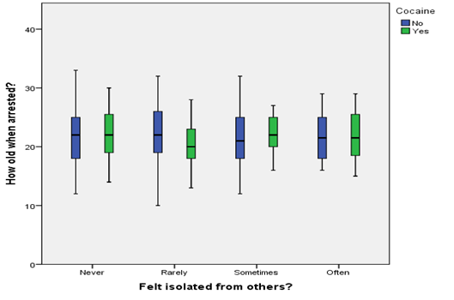
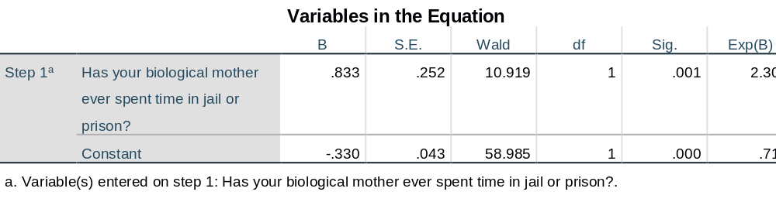
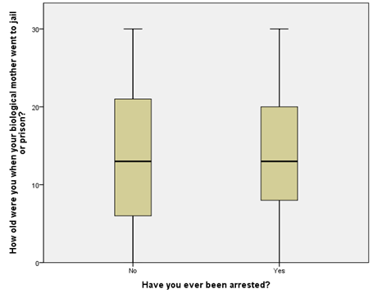
The association between a biological parent spending time in jail/prison and the child ending up in jail/prison later in life.
Kathleen Johnson
*Department of Nutrition and Food Sciences, California State University, Chico
Introduction
The United States has the highest incarceration rates in the world according to The Population Reference Bureau (2016). Considering the impact that a person being incarcerated has on not only their personal social groups, but also their community, the reasons behind incarceration should be studied. Finding these connections is integral to developing effective interventions and reducing the amount of people incarcerated each year.
In addition to the social costs of mass incarceration are substantial financial costs. On average, according to the Legislative Analyst’s Office, it cost almost $71,000 a year to hold one inmate in California (2017).
Intergenerational incarceration, or different generations of a family being incarcerated at some point in their life, may increase the risk of the child being incarcerated later in life. If a connection is found, that would open more opportunities for intervention to prevent the child ending up in jail or prison later.
Background
Intergenerational incarceration
Most of the literature discusses that the child may be at an increased risk for being incarcerated later in life if that parent, or even grandparent, has spent time in jail or prison. The literature leaves room for more studies to be done, specifically directly on looking at a population of parents that were incarcerated and then looking at if the child was later in life.
Effect of parental incarceration on a child’s behavior
Almost all of the literature reviewed mainly looked at the effect that a parent's’ incarceration has on the child’s behavior. Then they touch on the risk or likelihood that the child will then later end up in jail or prison. Some of the behaviors sighted throughout the literature were antisocial behavior, aggression, depression, etc.
Problem
Incarceration rates are high in the United States
High costs to society
Prevention efforts could be implemented at different stages
  Before involvement with criminal justice system
  During incarceration - prevent recidivism
  After incarceration - prevent recidivism
Research what leads a child to end up involved with the criminal justice system later
  Childhood trauma
  Parental incarceration
    Role modeling
    Trauma leading to depression, isolation, etc.
Hypothesis
There is a relationship between the effect a biological parent being in jail/prison and the child ending up in jail/prison later in life?
Methods
AddHealth Data
5,114 participants
Age between 24-32
Combination of 90-minute interview & electronic survey
Male & Female included
Ethnicity: Ranges
Variables Used
Has your biological mother ever spent time in jail or prison?
How old were you when your biological mother went to jail or prison (the first time)?
Have you ever been arrested?
Have you ever spent time in a jail, prison, juvenile detention center or other correctional facility?
Has a doctor, nurse or other health care provider ever told you that you have or had: depression?
How often do you feel isolated from others?
Results
The original ANOVA and the stratified ANOVA models were not significant with a p-value of .401 and .383 respectively. There is not a clear difference in the relationship between the average age of when someone was arrested and whether they have felt isolated from others when cocaine use was taken into account. So, cocaine use is not a moderating variable for this relationship.
Results
Null Hypothesis: There is no difference in the average age of adults who had mother that went to jail between people who have been arrested and those who have not.
Alternate Hypothesis: There is a difference in average age of adults who had mother that went to jail between those who have been arrested and those who have not.
After adjusting for the potential confounding factor of gender, having a mother go to jail or prison (2.3, (1, .001), p = .000) was significantly and positively associated with the likelihood of being arrested. In this analysis, the odds ratio tells us that those who are who have had a mother been in jail or prison are 2.3 times more to be arrested. Based on these analyses, gender is not a confounding factor because the association between explanatory and response is still significant after accounting for gender.
Conclusion
According to the results from the multiple tests run on these variables, there seems to be a relationship between having a biological mother having spent time in jail or prison and then ending up being arrested later in life. This is shown by the multivariate analysis of if the mother went to jail or prison and if the participant has been arrested at some point (p-value of .001). The initial literature review discussed the possibility of intergenerational incarceration being related to being arrested, which seems to be in line with my results.
Implications
Some limitations of this study were the limited number of related variables. A survey using only related questions would be more informative. There needs to be more research done with intergenerational incarceration to be able to accurately identify if there is a relationship between a parent being incarcerated and the participant being arrested later in life. There also should be further research done on what the factors are that lead to that. (i.e. behavior changes, poverty levels, etc.)
References
Tsai, T. & Scommegna, P. (2016). U.S. Has the World’s Highest Incarceration Rates. Population Reference Bureau. Retrieved from
http://www.prb.org/Publications/Articles/2012/us-incarceration.aspx
Farrington, D. P., Coid, J. W. and Murray, J. (2009), Family factors in the intergenerational transmission of offending. Criminal Behav. Ment. Health, 19: 109–124. doi:10.1002/cbm.717
Kinner, S. A., Alati, R., Najman, J. M., & Williams, G. M. (2007). Do paternal arrest and imprisonment lead to child behaviour problems and substance use? A longitudinal analysis. Journal Of Child Psychology & Psychiatry, 48(11), 1148-1156. doi:10.1111/j.1469-7610.2007.01785.x
Legislative Analyst’s Office. (2017). How much does it cost to incarcerate an inmate? Retrieved from http://www.lao.ca.gov/PolicyAreas/CJ/6_cj_inmatecost
Murray, J., & Farrington, D. (2005). Parental imprisonment: Effects on boys’ antisocial behaviour and delinquency through the life‐course. Journal of Child Psychology and Psychiatry, 46(12), 1269-1278.
Ng, I. H., Sarri, R. C., & Stoffregen, E. (2013). Intergenerational Incarceration: Risk Factors and Social Exclusion. Journal Of Poverty, 17(4), 437-459. doi:10.1080/10875549.2013.833161
This looks at the participants that had a biological mother spend time in jail/prison. Out of the participants who have been arrested, they had a biological mother that went to jail/prison at a slightly lower average age at 13.45 years old, which is .038 less than those who have not been arrested (13.49 years old). This is a non-significant difference with a p-value of .978. Do not reject the null hypothesis. Looking at the Levene’s test of .200, the variance is about the same and conforms to the assumption of homogeneity of variance.

